Slide 1
LoRa Gateway Power Management
Robert Cooney, Stephen Farrell, Kerry Hartnett

Slide 2
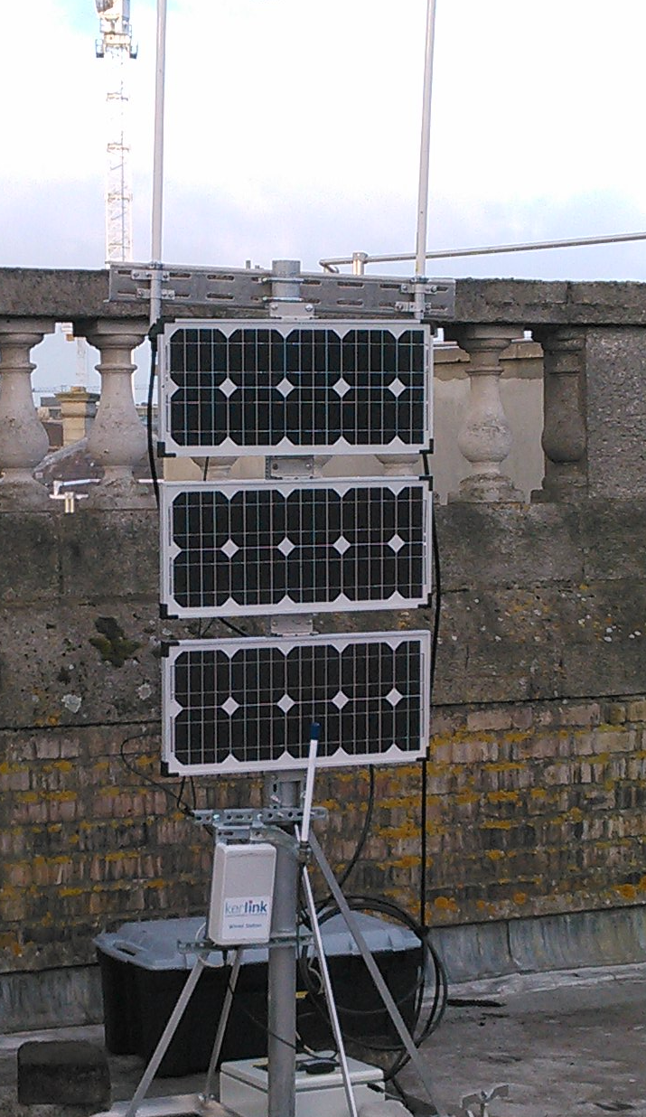
Inherited Kerlink LoRaWan gateway with solar-powered DTN router assembly
Was mounted on roof in TCD from January - September 2017

Slide 3
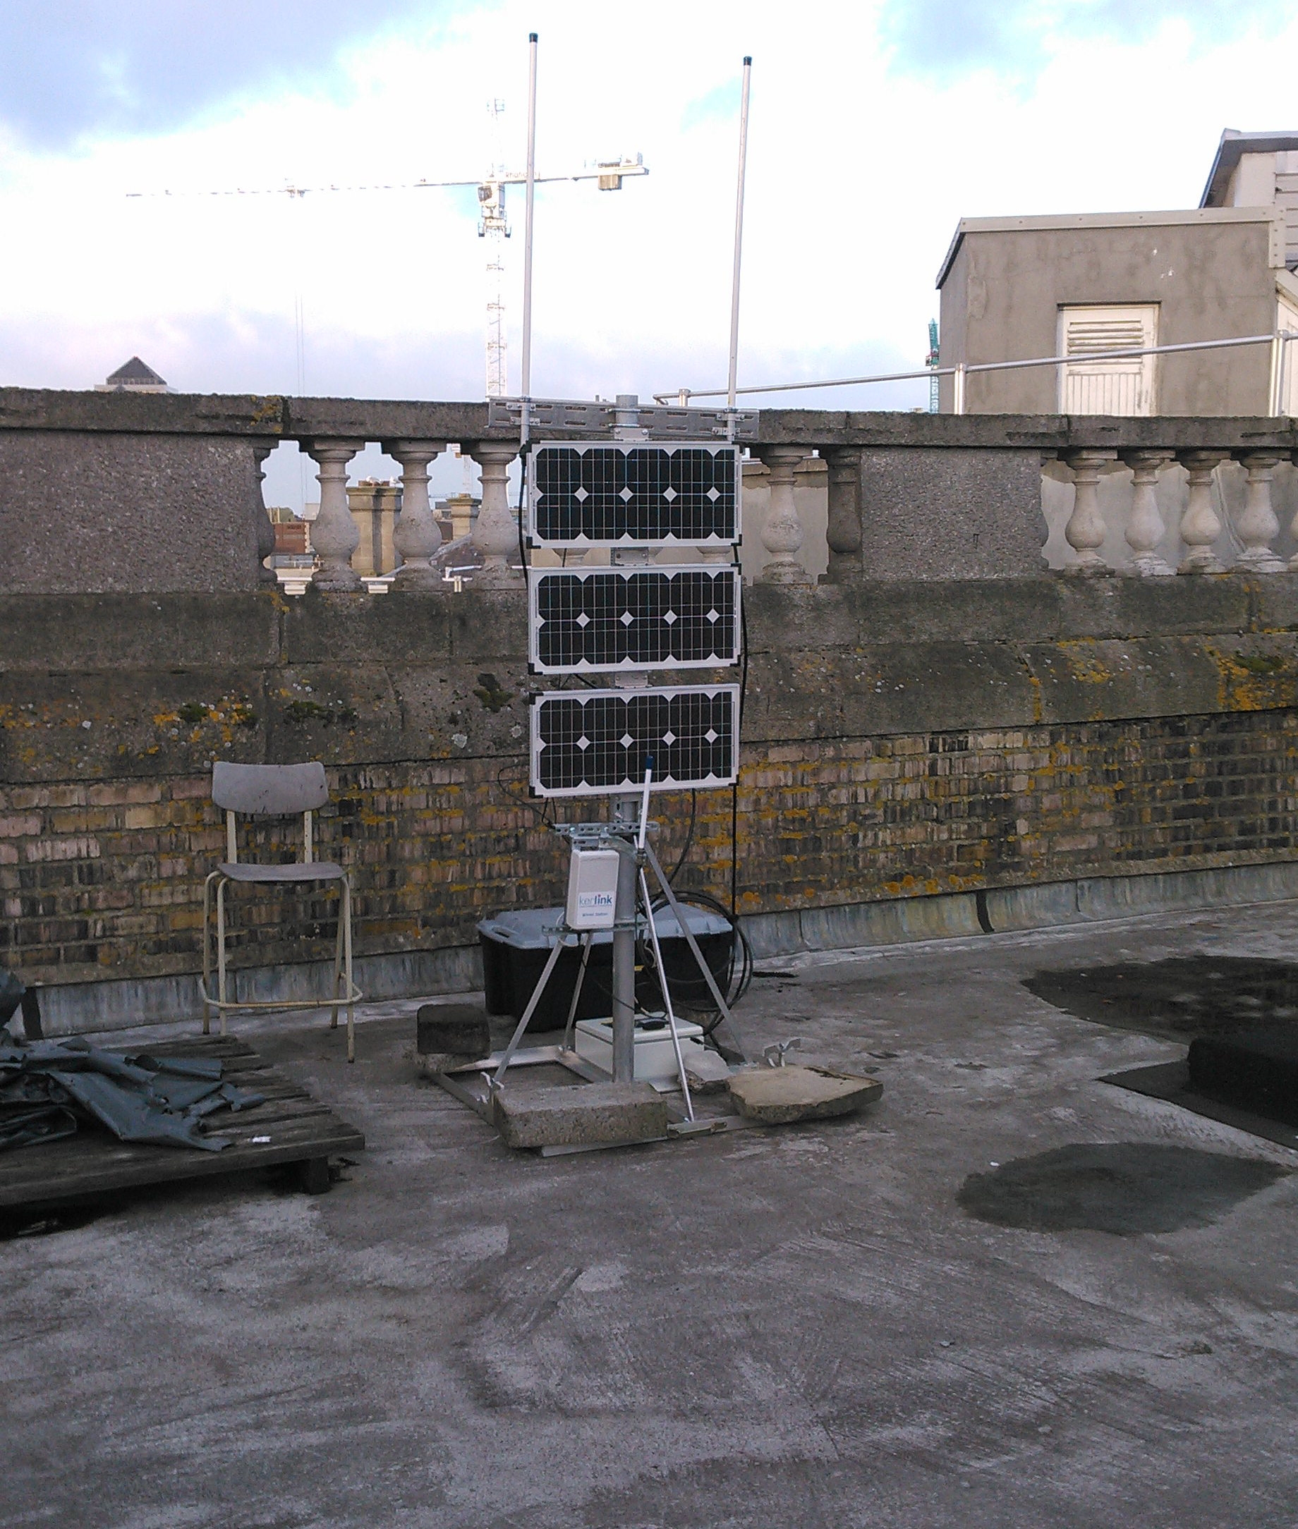
What Is It?
LoRaWAN stands for Long Range Wide Area Network, which is a specification used mainly by battery operated devices in the Internet of Things.
Devices use LoRaWAN to connect to the gateway, and they can then use this connection to remotely report data they have collected
The gateway is solar-powered, so its operation is dependent on the weather at the time - “Up” state if weather is good, “Low power” or “Sleep” state if weather is poor for extended period of time

Slide 4
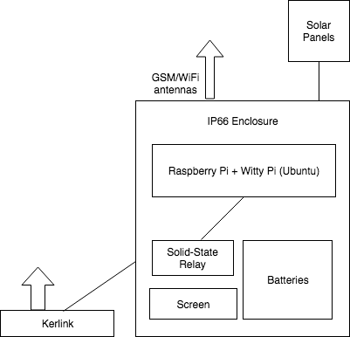
Setup
Previous build used Eurotech Board Controller (which died)
Replaced Board with Raspberry Pi + Witty Pi for power management and RTC, and Solar Charge Controller - See references slide for more details

Slide 5
Goals
Get old daemon working with new setup - Raspberry Pi, Witty Pi
Rewrite code power management daemon to make it more clear, maintainable and concise while keeping core functionality intact
Introduce configuration options to allow for customisation of operation, such as choice of length of time to sleep when down

Slide 6
Power Management
Power management code rewritten to introduce smarter sleep/wake patterns
Sleep/turn off at set voltage threshold, low power state (doesn’t power gateway) for telemetry purposes
Sleep modes - greedy, moderate, conservative - impact length of time device is powered off
Also supports relative sleep patterns eg. Sleep for 10 minutes of every 60 - note that in this case, greedy/moderate/conservative sleep will still apply when battery is too low

Slide 7

More Power Management
Logging enabled -> /var/log, can be used to compare statistics for different configurations - determine optimal setup to maximise uptime
Simulated voltage used for testing purposes in lab development

Slide 8
Demo
Initial 2 runs won’t update screen after reboot as startup script is not present initially
First run with Greedy mode configured, and simulated voltage depletion - should wait for voltage to deplete below threshold 1060V, sleep for short time (1 minute for demo purposes), then wake
Second run with Greedy mode and relative sleep pattern - stays awake for 1 minute then sleeps for 1 minute
Third run with Moderate mode enabled and script copied to init.d - should run on startup

Slide 9
Code Rewrite
Code for power management daemon rewritten based on existing material
Some files/functions salvaged from old code such as phidget code from phidget library (used to track voltage/current and display status on screen)
Main rewrite was of pbmd.c, which is the main file for the daemon
Code repo @ https://github.com/sftcd/loradtn-pi

Slide 10
References
“An N4C DTN Router Node Design”, Stephen Farrell, Stefan Weber, Alex McMahon, Eoin Meehan and Kerry Hartnett, 1st Extreme Workshop on Communication, Laponia, Sweden, 2009/08/14
Previous data available at https://basil.dsg.cs.tcd.ie/code/tcd/loradtn
UUGear Witty-Pi Realtime Clock + Power Management for Raspberry Pi
Phidgets library @ phidgets.com
Git Repo @ https://github.com/sftcd/loradtn-pi

